Slide 1
Microbial Community analysis
Erick Cardenas Poire
University of British Columbia

Slide 2
Why study microbial communities?

Slide 3
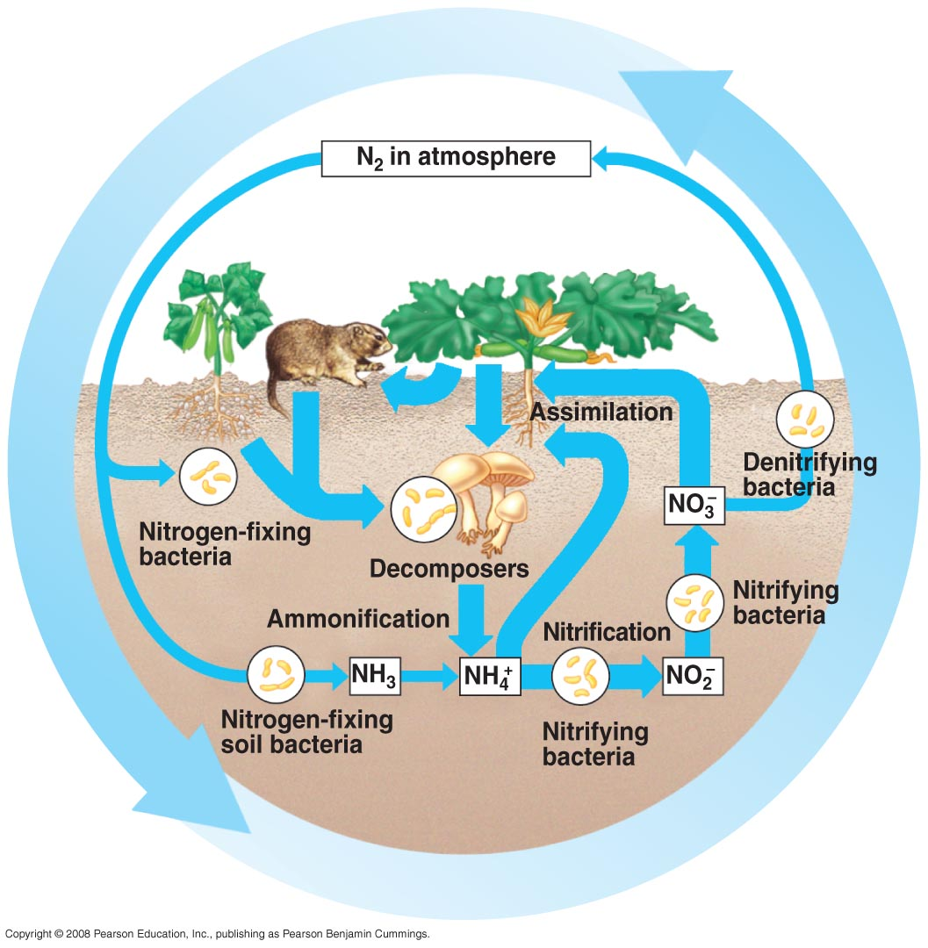
1. Microorganisms have important roles
Important players in biogeochemical cycles
(C,N,S, etc.)
http://apbiosemonefinalreview.pbworks.com/f/55_14cNitrogenCycle-L.jpg

Slide 4
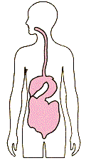
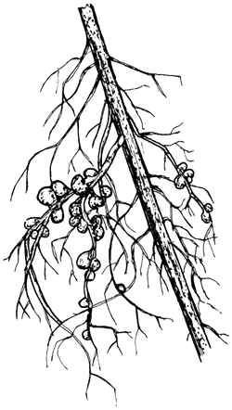
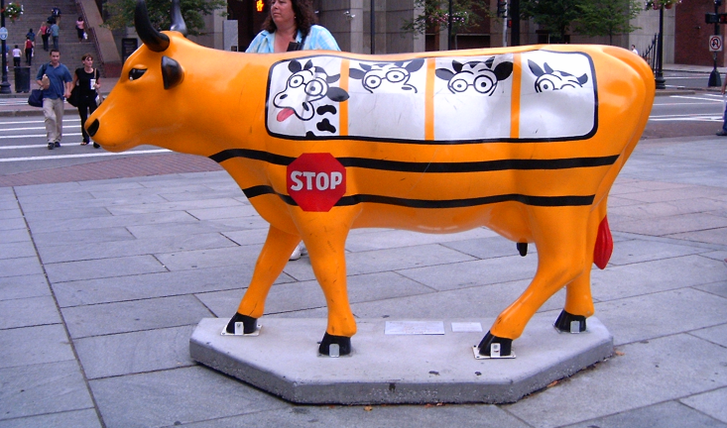
1. Microorganisms have important roles
Important interactions with other organisms, including humans
http://www.fao.org/docrep/006/ad228e/AD228E93.gif

Slide 5
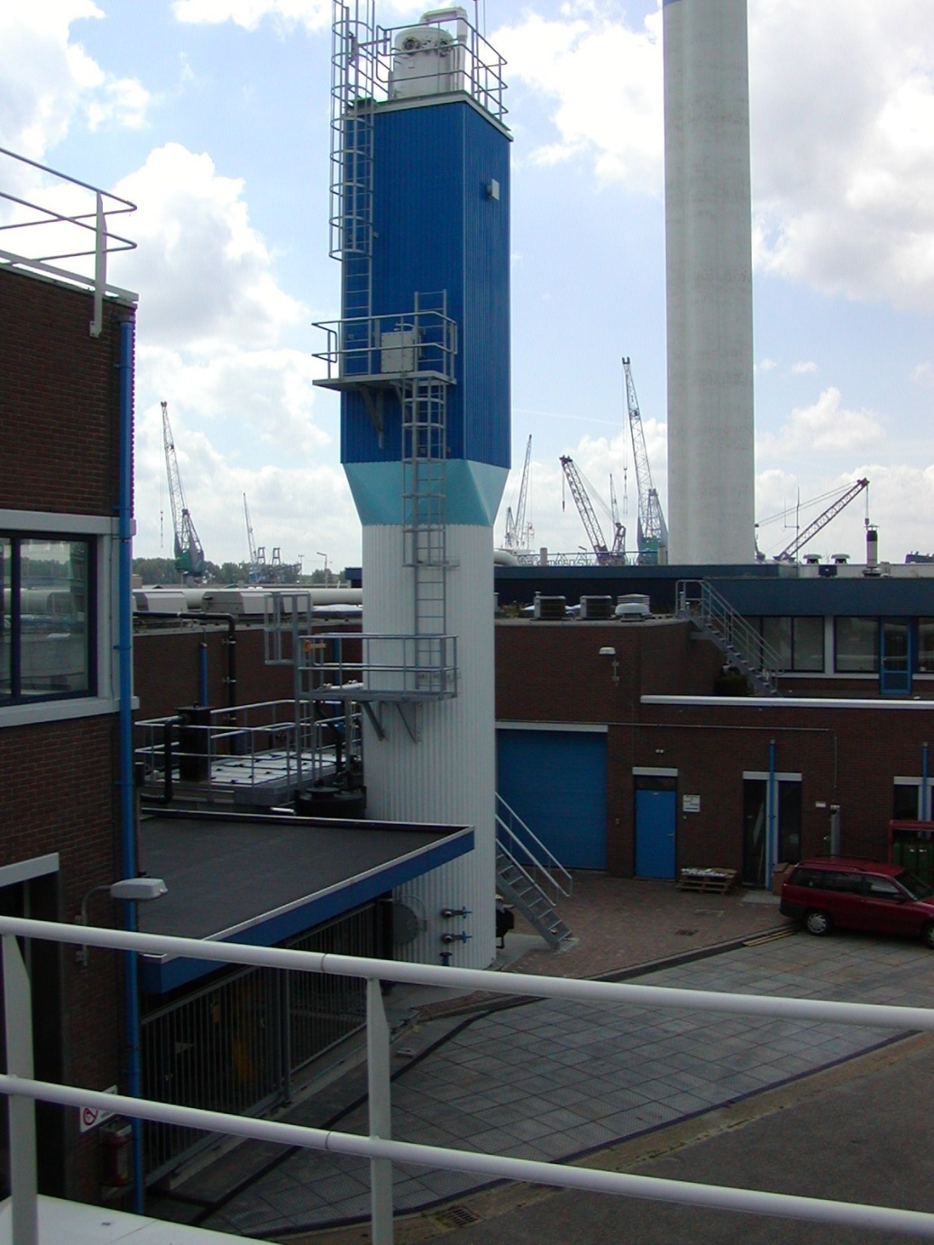
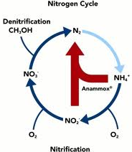
1. Microorganisms have important roles
Biotechnological potential
Wastewater treatment using anaerobic ammonia oxidation.
↓60% energy consumption
↓ 88% CO₂ emmmisions
↓ 50% space use
Anammox bioreacton from: http://www.twanetwerk.nl

Slide 6
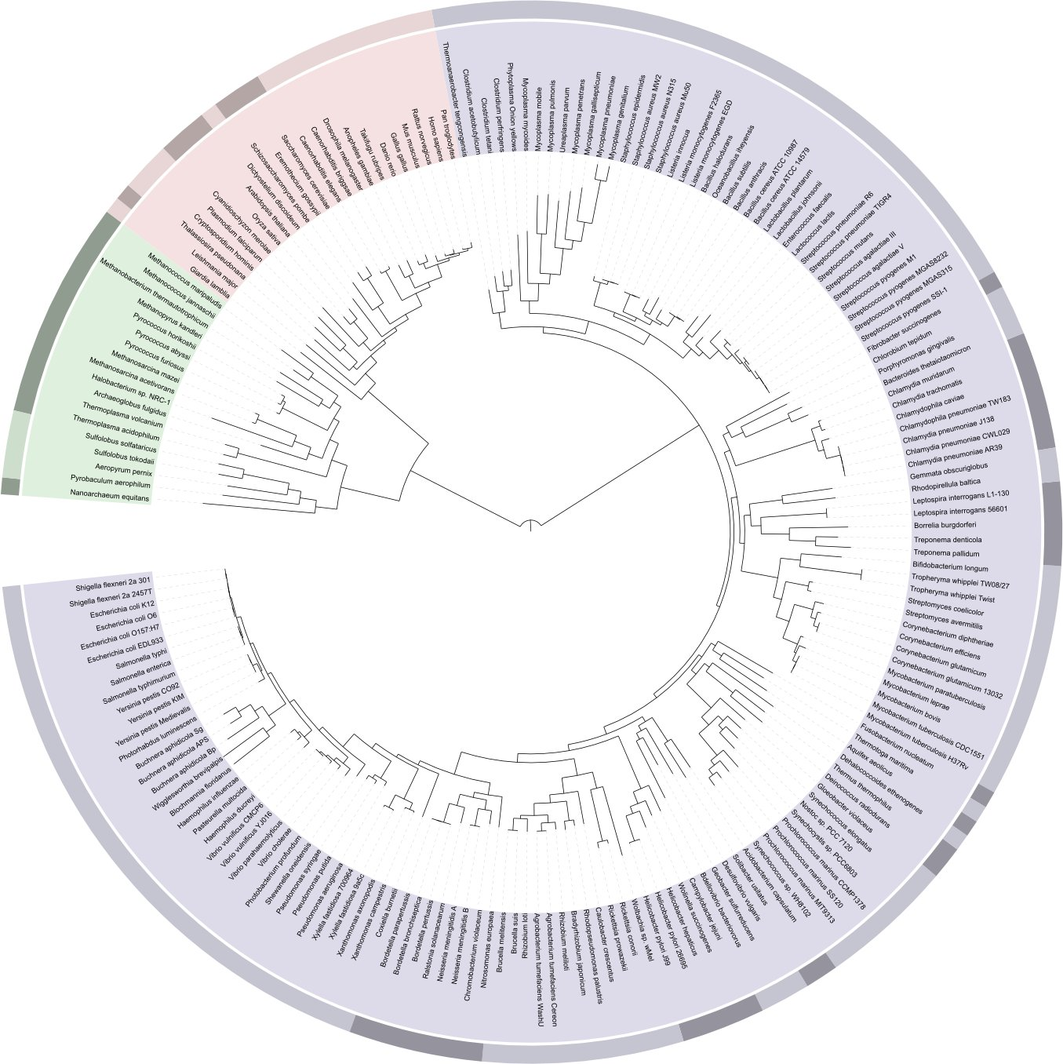
1. Microorganisms have important roles
Highest metabolic and genetic diversity
Humans

Slide 7
2. Sequencing costs have considerably decreased
Data from National Human Genome Research Institute (http://www.genome.gov/sequencingcosts/)

Slide 8
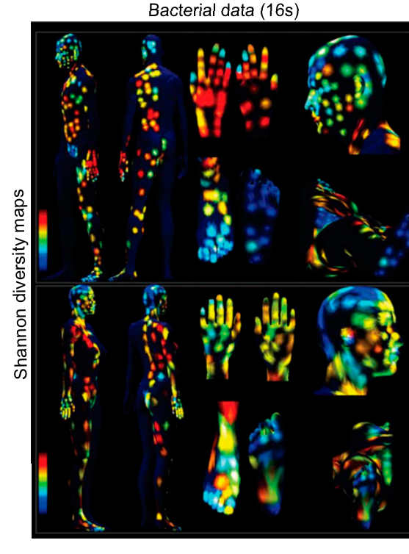
3. We know little about the microorganisms
Most abundant living organisms (4-6 x 10³⁰)
Many unexplored ecosystems
Many unexplored groups
Uncultivated phyla
Archaeas
Fungi
PNAS April 28, 2015 vol. 112 no. 17 E2120-E2129

Slide 9
What is diversity?

Slide 10
Diversity, definitions
Magurran:
The variety and abundance of species in a defined study unit.
Alpha diversity:
Diversity in a spatial unit
Within community
Beta diversity
A measurement of how two or more spatial united differ
Among communities

Slide 11
Alpha diversity
Richness (S): How many different species exist
Evenness: Species distribution
=
>
Richness
Evenness
=
<

Slide 12
Alpha diversity indices
A metric that considers one or more diversity components
Shannon (H’)
Simpson (D)
Chao1

Slide 13
Shannon diversity index (H’)
Number of species
Proportion of the
community given by
species i

Slide 14
Shannon’s index limits
Range : 0 - ∞
Heavily influences by richness

Slide 15
Calculating Shannon’s index
Sample 1
Sample 2
H’= 1.279854
H’=0.940448
 | Count |  | Pi |  | ln(pi) |  | pi.ln(pi)
 | Sample1 | Sample2 | Sample1 | Sample2 | Sample1 | Sample2 | Sample1 | Sample2
Sp1 | 4 | 7 | 0.4 | 0.7 | -0.916 | -0.357 | -0.367 | -0.250
Sp2 | 3 | 1 | 0.3 | 0.1 | -1.204 | -2.300 | -0.361 | -0.230
Sp3 | 2 | 1 | 0.2 | 0.1 | -1.610 | -2.300 | -0.322 | -0.230
Sp4 | 1 | 1 | 0.1 | 0.1 | -2.302 | -2.300 | -0.230 | -0.230
 | 10 | 10 |  |  |  |  | -1.27985 | -0.940

Slide 16
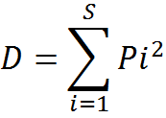
Simpson’s index (D)
Total number
of species
Proportion of the
community given by
species i
Probability of selecting the same species when sampling two members at random the same

Slide 17
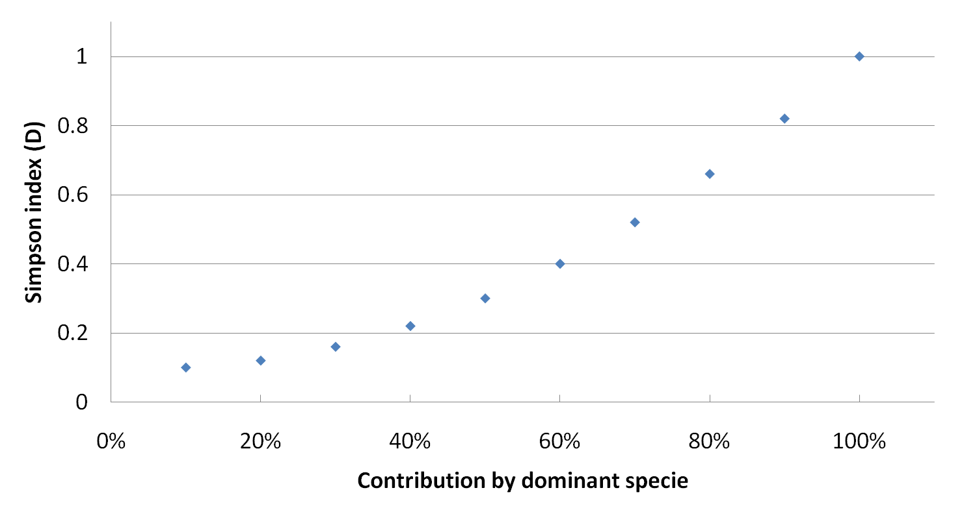
Simpson’s index (D)
Range : < 0 – 1 ]
Strongly influenced by evenness
Usually presented as (1-D)
Contribution by dominant species

Slide 18
Calculating Simpson’s index
Sample 1
Sample 2
D=0.3
1-D =0.7
D=0.52
1-D =0.48
 | Count |  | Pi |  | Pi2
 | Sample1 | Sample2 | Sample1 | Sample2 | Sample1 | Sample2
Sp1 | 4 | 7 | 0.4 | 0.7 | 0.16 | 0.49
Sp2 | 3 | 1 | 0.3 | 0.1 | 0.09 | 0.01
Sp3 | 2 | 1 | 0.2 | 0.1 | 0.04 | 0.01
Sp4 | 1 | 1 | 0.1 | 0.1 | 0.01 | 0.01
 | 10 | 10 |  |  | 0.3 | 0.52

Slide 19
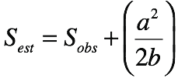
Chao1index
Estimates total diversity using frequency of rare species
Can overestimate diversity due to sequencing error
Observed species (S_{obs}) = 5
Singletons (a) = 2
Doubletons (b) =1
S_{est}= 5+(2²/2x1) = 7

Slide 20
Simpson evenness index
(1/D)
Limits 1/S - S
Dominant species contribution

Slide 21
Rank-Abundance curves
Show both richness and evenness
Steep slopes suggest strong selective pressure
Curves can indicate distribution of resources

Slide 22
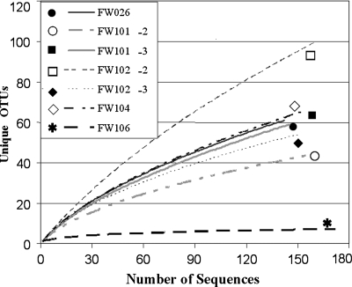
Rarefaction curves
Used to compare diversity when sampling was done at different levels.
Sometimes used to estimate if coverage has reached a plateau.
Are only informative when saturated.

Slide 23
Diversity, definitions
Magurran:
The variety and abundance of species in a defined study unit.
Alpha diversity:
Diversity in a spatial unit
Within community
Beta diversity
A measurement of how two or more spatial united differ
Among communities

Slide 24
Beta diversity
Diversity among communities
Uses abundance and occurrence
Commonly used indices
Jaccard (Occ.)
Sørensen (Occ.)
Bray-Curtis (Occ. + Ab.)
Chao-Sørensen (Occ. + Ab.)

Slide 25
Presence/absences indices
a
b
c
Sample 1
Sample 2
Jaccard = b / (a+b+c)
Sorensen (QS) = 2b /(a+2b+c))
More weight to shared species

Slide 26
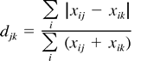
Indices using both abundance and occurrence
Bray -Curtis
Chao-Sorensen
Considers both abundance and assumes suboptimal sampling.
Absolute differences in abundance for i in samples j and k
Sum of abundance for
i in samples j and k

Slide 27
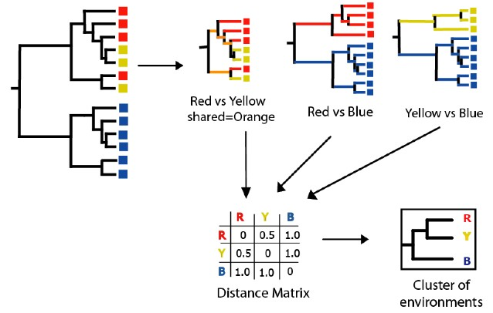
Tree-based indices
UNIFRAC
Based on phylogenetic diversity.
Useful when comparing very different environments with not many common species.

Slide 28
Ways to represent Beta diversity
 | Sp1 | Sp2 | Sp3 | Sp4 | Sp5 | Sp6
Sample1 | 8 | 0 | 12 | 10 | 1 | 100
Sample2 | 3 | 0 | 12 | 40 | 5 | 0
Sample3 | 10 | 0 | 12 | 10 | 11 | 15
Sample4 | 4 | 1 | 12 | 2 | 8 | 3
Create species by sample table
Sample1 Sample2 Sample3
Sample2 0.84
Sample3 0.67 0.65
Sample4 0.84 0.67 0.50
Create a distance matrix
Cluster Dendrogram
0.80
Create a clustering tree or ordination
0.70
0.60
Sample1
Height
0.50
Sample2
Sample3
Sample4

Slide 29
Now some examples…

Slide 30
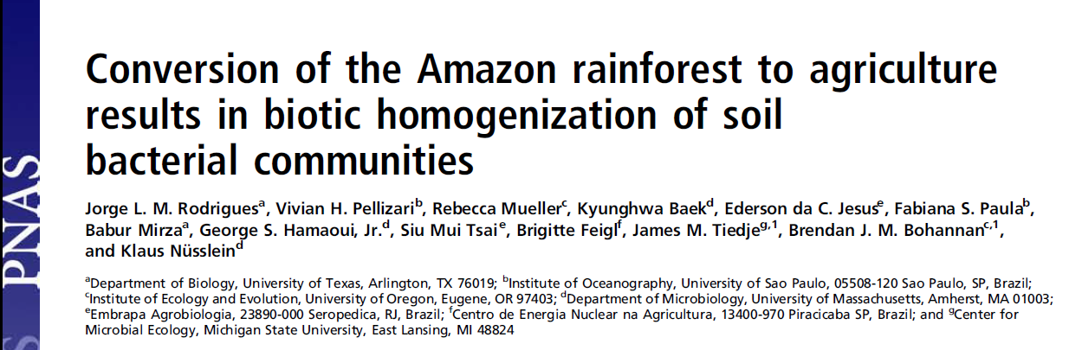
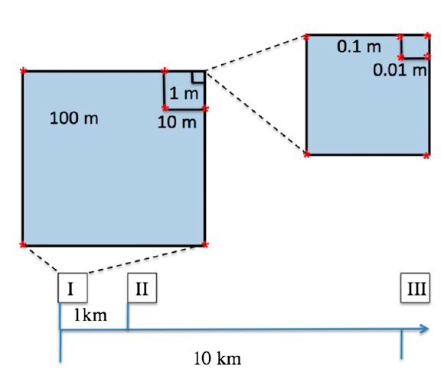
Nested blocks design
Natural forest converted to pastures
Diversity analysis of 16S rRNA data using 454 data with MOTHUR and RDP

Slide 31
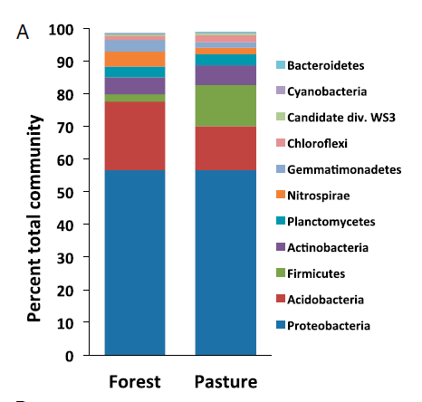
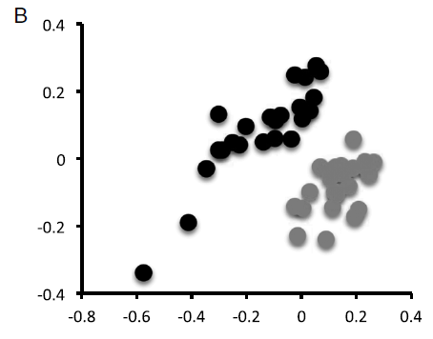
Conversion to agriculture affects the community composition
Forest
Pasture
Classification using representative sequences
NMDS using
Bray-Curtis distances
Notes:
Is this a alpha or beta diversity analysis?

Slide 32
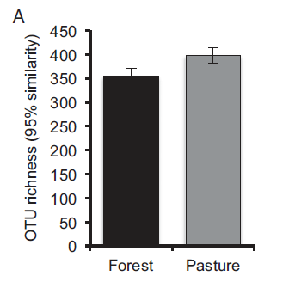
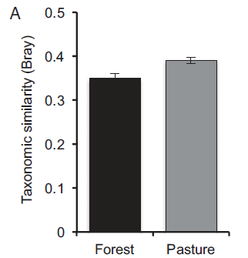
Conversion increases the communities’ diversity
Alpha diversity changes
Beta diversity changes
Notes:
Is this a alpha or beta diversity analysis?

Slide 33
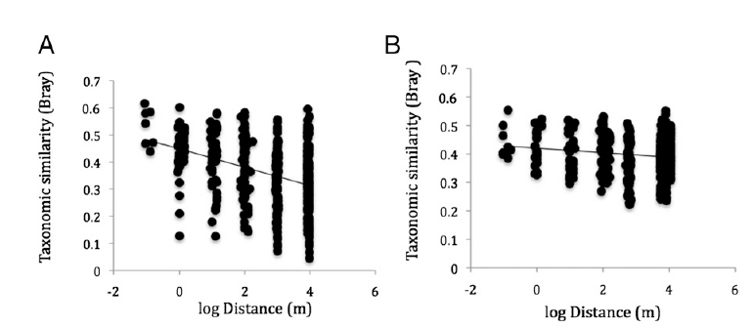
Conversion to agriculture homogenizes the communities
Forest
Pasture
Notes:
Is this a alpha or beta diversity analysis?

Slide 34
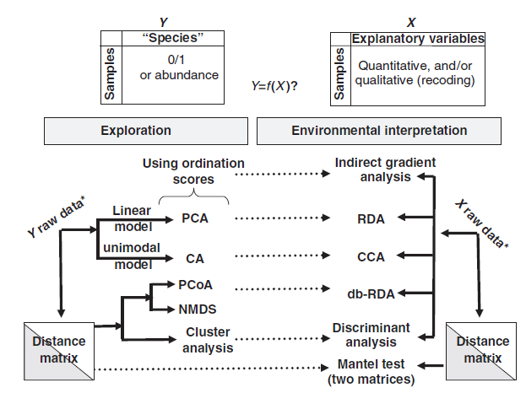
But wait, there is more

Slide 35
Resources
Multivariate analysis in microbial ecology. Ramette 2007. FEMS Microbiol Ecol 62:142-160. DOI:10.1111/j.1574-6941.2007.00375.x
Tree diversity analysis: A manual and software for common statistical methods for ecological and biodiversity studies. Roeland Kindt and Richard Coe. World Agroforestry Centre, Nairobi, Kenya. www.worldagroforestry.org/downloads/Publications/PDFS/b13695.pdf (Free, includes R codes)

Slide 36
Diversity - Summary
The variety and abundance of species in a defined study unit.
Alpha
Within a community (Species diversity in a site or habitat)
Richness, Evenness
Chao1, Simpson, Shannon Index
Beta
Among communities (Differentiation of habitats)
Sorensen, Jaccard, Bray-Curtis indices
Clustering, ordinations

